Slide 1
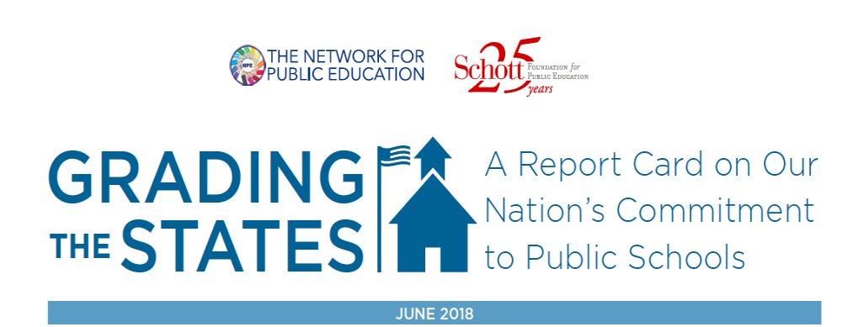
A report that evaluates the extent to which the 50 states and the District of Columbia are funneling public money away from community public schools to charters, vouchers and voucher-like programs. The report also measures the consequences of school privatization on students’ civil rights and taxpayers’ rights to know how their dollars are spent.
Notes:
Only extensive report on privatization that has not been produced by a charter or voucher advocacy organization.
Living document

Slide 2
We Reviewed and Rated State Laws and Regulations Regarding Vouchers, Neo-vouchers and Charters on the Following Five Criteria:
Types and Extent of School Privatization
Civil Rights Protections for Students in Voucher and Charter Programs
Accountability, Regulations and Oversight
Transparency of Voucher and Charter Programs
Other Factors Related to Charter School Accountability
Notes:
Types: Vouchers take a variety of forms– talk about in a few moments—whether the state allowed charter schools and whether they were authorized only by the district. Eligibility in the case of vouchers, and % of enrolled students in the case of charters
Civil Rights—especially relevant for voucher programs. Laws discrimination based on religion, allow opt out from prayer? Voucher schools required to take students with disabilities and ELL students.
Accountability and oversight: Teachers certified if the school took public money. Are there regular audits? Open public governance meetings? Is their an accredition requirement.
Transparency : Students Performance and spending
Other factors: shared space requirements, kinds of charters, charter caps, whether the charter has to follow public school regulations regarding student discipline.
Sources: National Council of State Legislatures database, State regulations of Private and Homeschools, data bases and reports of EdChoice and National Alliance of Charter Schools, laws and regulations themselves.

Slide 3
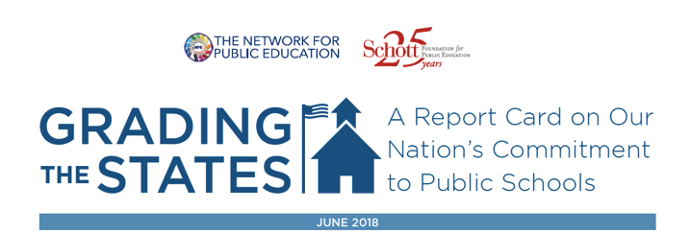
The Three Primary Voucher Programs
Traditional Vouchers: Tax dollars given to parents to support tuition at private elementary and secondary schools.
Education Savings Accounts (ESAs): Tax dollars given to K-12 parents, often on a debit card, to be used for educational expenses including tuition at private schools, online programs, therapy services, homeschooling or college tuition in exchange for non-enrollment in a public or charter school.
Tuition Tax Credit Programs (TTCs): Businesses and individual taxpayers credits against their state income taxes for contributions to School Tuition Organizations (STOs). STOs then award tuition grants to families for private schools. The portion of the tax credit varies from state to state, with some states awarding a 100% credit.
Notes:
Go by different names in different states
Many states have several—up to five
There are deductions
Estimate the cost (EdChoice numbers) almost 2.4 billion dollars

Slide 4
Overview and selected findings:
28 states and D.C. have one or more of the following: traditional vouchers, ESA accounts, TTCs.
All but 3 states have a voucher program, charter program or both.
33 states allow for-profit companies to manage their charter schools. Four allow for-profit charters.
19 states fail to include additional state and local civil rights protections that go beyond race, ethnicity and national origin in at least one of their programs.
23 states and D.C. fail to protect students in their voucher program against religious discrimination.
15 states with voucher/neo-voucher programs fail to require employee background checks.
28 states plus D.C. fail to require the same teacher certification as public schools in their charter schools.
13 of the 16 states with traditional Vouchers, 4 of the 6 ESAs and 15 of the 18 states with TTCs do not require prior public or charter school enrollment to receive a voucher.
13 states allow conflict of interest between the charter school board and the CMO or vendors.

Slide 5
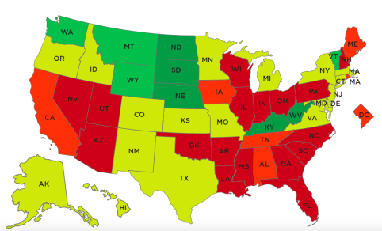
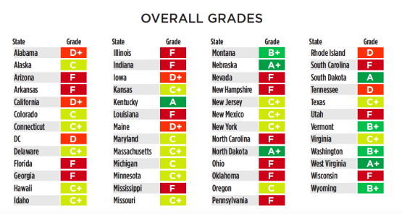
The Grades
Notes:
3 A+ states–(talk about those in a moment) 17 received a grade of F
Very low scores: Arizona, Florida, Georgia, North Carolina and Nevada at the bottom--not only for the extent of privatization as well as their laws regarding discrimination and accountability

Slide 6
States That Do it Right (or Better)
Nebraska, North Dakota and West Virginia give full support to public education, rejecting both charters and vouchers.
In Kansas, Maryland, Virginia and Wyoming only the school district can authorize a charter school. Rejected charter applicants cannot authorizer shop.
Montana has no charter schools, and its TTC program is extremely limited.
Texas successfully thwarts voucher and neo-voucher proposals every year, despite considerable pressure from voucher-friendly legislators.
Vermont’s “voucher” program (town tuition program) is available only to students without a public school in their town. Students can enroll in another town’s public school or a secular private school only.

Slide 7
Recommendations
Taxpayer dollars should not support private school vouchers, ESAs, TTCs or any future scheme to circumvent state prohibitions on the use of tax dollars for religious entities.
There should be a moratorium on all voucher programs with an immediate phase out that does not displace children presently in the voucher system.
Special tax credits for businesses and individuals should be eliminated with scholarship programs receiving the same tax benefit (deductibility) as other charitable programs.
Charter schools should be absorbed into the district public school system to be governed by those elected by the community.
We support the NAACP moratorium on charter schools - we should invest in public schools to make them better for all students.
We support evidenced-based actions steps and increased,
equitable funding to improve our public schools.

